Slide 1

What makes a project exciting?
Data Analyst Chalenge
Name: Cesar Roma Filho

Slide 2
Overview
The challenge consists of identifying what makes a project exciting and it is based on Kaggle competition from Donorschoose.org.
To answer this question the competition has 4 datasets from more than 664 thousand projects from 2012 till 2014.
The datasets contain 83 fields related to the projects with information from the schools, donations, socio-geographic, etc.
To be considered exciting the project must meet 5 criteria, these criteria and the label with projects already considered exciting are in the data set outcome.csv.
For the clean, analysis and data visualization of the data it was used mainly Power BI and python with the following libraries:

Slide 3
Exploratory Data Analysis- Outcomes
Requirements for project be exciting
5 requirements:
Fully donated
1 teacher referred donor
Higher than average percentage of donors leaving an original message (great chat)
At least one green donation ()
Has one or more of:
donations from three or more non teacher-acquired donors
one non teacher-acquired donor gave more than $100
the project received a donation from a "thoughtful donor"
Some projects with dates of 2014 were still running when the challenge was released, so most of the analysis will be used projects with date before 2014
On the outcomes data set we have ~619 thousand projects.
~36 thousand projects considered exciting which is ~6% of the total.

Slide 4
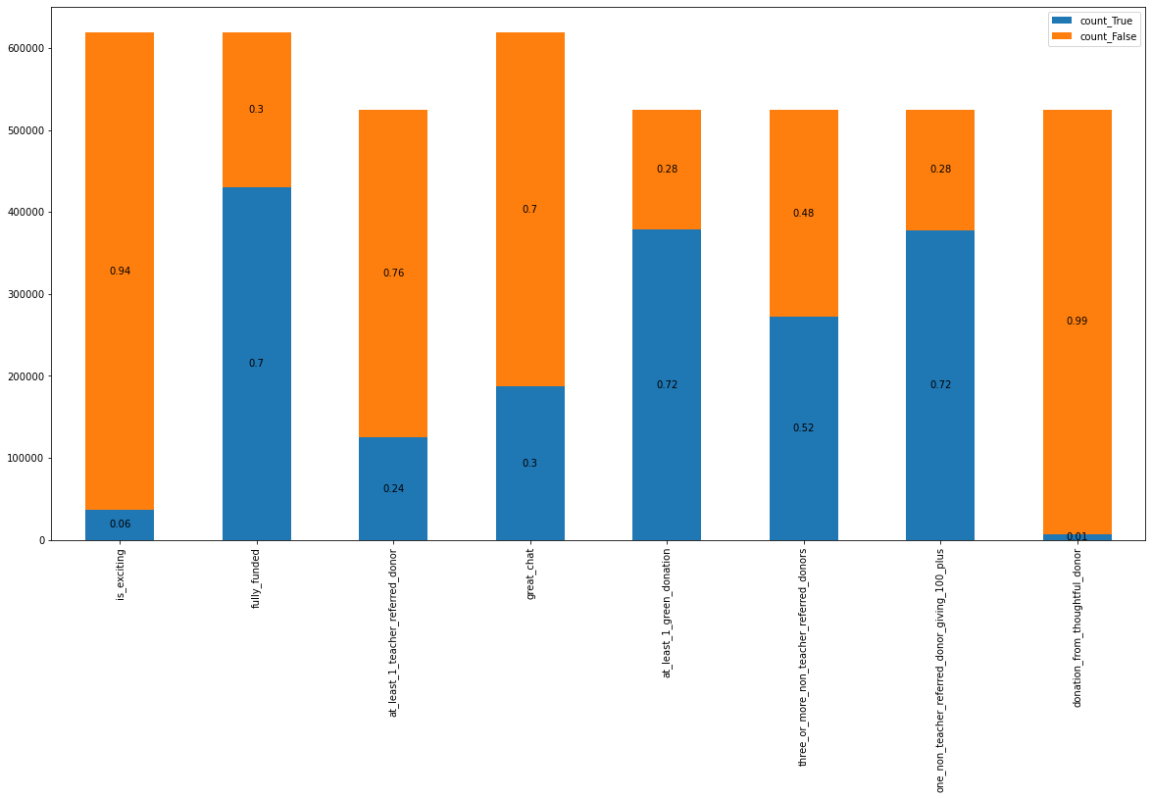
Exploratory Data Analysis- Outcomes
Requirements Count
Requirements vs Exciting
fully_funded | 1_teacher_referred_donor | great_chat | 1_green_donation | Not_excting | Exciting
f | f | f | f | 26,305 | 0
f | f | f | t | 14,343 | 0
f | f | t | f | 17,311 | 0
f | f | t | t | 21,085 | 0
f | t | f | f | 1,184 | 0
f | t | f | t | 6,215 | 0
f | t | t | f | 932 | 0
f | t | t | t | 7,281 | 0
t | f | f | f | 84,610 | 0
t | f | f | t | 137,641 | 0
t | f | t | f | 11,939 | 0
t | f | t | t | 87,034 | 0
t | t | f | f | 3,041 | 0
t | t | f | t | 64,441 | 0
t | t | t | f | 913 | 0
t | t | t | t | 3,943 | 36,710
Considered as 1 requirement
For the contingency table were drop the rows with null values.
We have ~ 87 thousands projects( %17 of the total) when all the requirements are True but not the teacher reference.
When just “Great Chat” is false we have 64 thousand projects (13% of total)

Slide 5
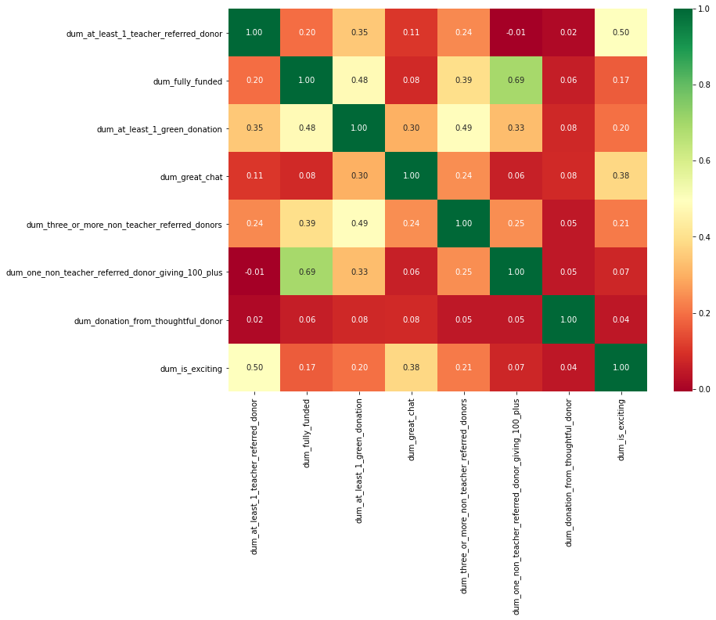
-To perform correlation the requirements were transformed in dummy variables (false=0, true=1). - The requirement if a donor came by a link from a teacher has the highest correlation ~0.5 with the with the classifier (is_exciting) -The importance of the teacher influence donors could be a key requirement
Exploratory Data Analysis- Outcomes
Correlations

Slide 6
-This test is better to perform if that is an association between categorical variables.(Hight values for Chi and pval shows association). - Cramer’ V test shows how big is this association(the higher the Cramer value the greater the association). -The importance of the teacher influencing donors could be a key requirement for the classifier.
Exploratory Data Analysis- χ² test
Chi square test
Variable | chi2 | pval | dof | critical value for Chi | flg_critical | flg_pval | cramer_test
at_least_1_teacher_referred_donor | 126729.8 | 0 | 1 | 10.83 | TRUE | TRUE | 0.66
fully_funded | 17090.92 | 0 | 1 | 10.83 | TRUE | TRUE | 0.24
at_least_1_green_donation | 15240.24 | 0 | 1 | 10.83 | TRUE | TRUE | 0.23
great_chat | 90096.65 | 0 | 1 | 10.83 | TRUE | TRUE | 0.56
three_or_more_non_teacher_referred_donors | 18659.2 | 0 | 1 | 10.83 | TRUE | TRUE | 0.25
one_non_teacher_referred_donor_giving_100_plus | 235.31 | 0 | 1 | 10.83 | TRUE | TRUE | 0.03

Slide 7
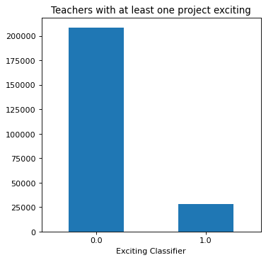
Exploratory Data Analysis- Schools Categorical
On the dataset was created a binary variable if the school has at least one exciting project (flg_teacher_exciting)
Exciting projects are even more concentrated in 11% of the teachers.
40 k
55 k
Teachers who are classified as exciting has on average ~6 projects released compared to the global average as 3.
15 k
15 k
American teachers has percentage 10 %of projects classified as exciting what is almost the double of the global percentage (6%)
15 k
28 k

Slide 8
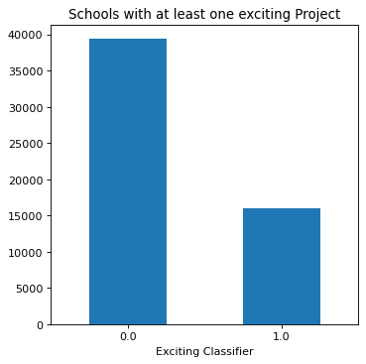
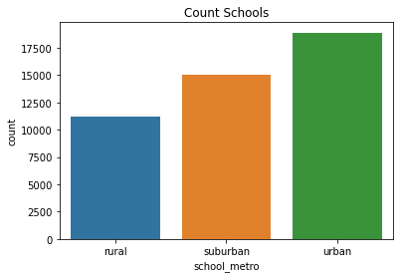
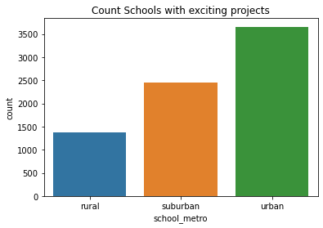
Exploratory Data Analysis- Schools
On the dataset was created a binary variable if the school has at least one exciting project (flg_school_exciting)
Exciting projects are concentrated in 30% of the schools.
The most correlated category with the school_excting is school_metro(if the school is situated in a metropolitan area), accordingly with Cramer’s V test.
40 k
15 k
35%
55%
35%
30%
55 k
29%
15%
40 k
15 k
15 k

Slide 9
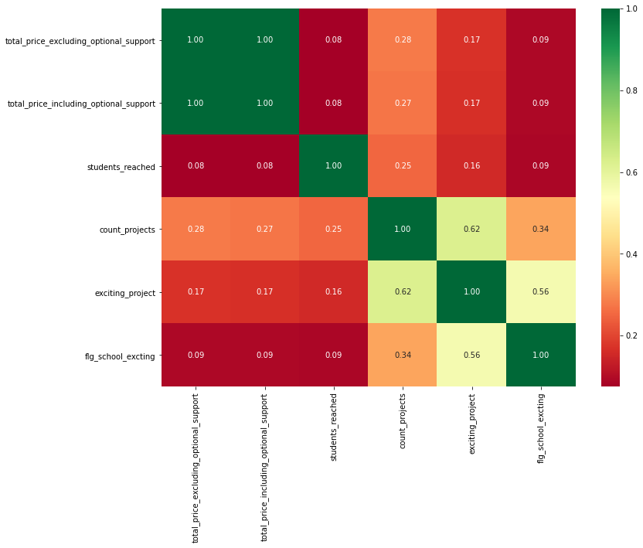
For continuous variables, just the correlation between number of projects per school and number of exciting projects per school are high correlated.
Exploratory Data Analysis- Schools
Correlations

Slide 10
The most correlated feature for projects is if the teacher already have a project classified as exciting or not. The other categories are correlated accordingly with the chi square, but the correlation are very small accordingly with Crame’s test
Exploratory Data Analysis- Projects
Categorical analysis Cramer’s test
Var | chi2 | pval | dof | critical value | flg_critical | flg_pval | cramer_test
primary_focus_subject | 519.12 | 0 | 26 | 38.89 | TRUE | TRUE | 0.01
primary_focus_area | 348.57 | 0 | 6 | 12.59 | TRUE | TRUE | 0.01
secondary_focus_subject | 393.84 | 0 | 26 | 38.89 | TRUE | TRUE | 0.01
secondary_focus_area | 85.53 | 0 | 6 | 12.59 | TRUE | TRUE | 0.01
resource_type | 382.35 | 0 | 5 | 11.07 | TRUE | TRUE | 0.02
eligible_almost_home_match | 12.83 | 0 | 1 | 3.84 | TRUE | TRUE | 0.01
grade_level | 63.03 | 0 | 3 | 7.81 | TRUE | TRUE | 0.01
eligible_double_your_impact_match | 31.9 | 0 | 1 | 3.84 | TRUE | TRUE | 0.01
flg_school_exciting | 22120.29 | 0 | 1 | 3.84 | TRUE | TRUE | 0.28
flg_teacher_exciting | 117914.8 | 0 | 1 | 3.84 | TRUE | TRUE | 0.64
55 k
40 k
15 k
15 k

Slide 11
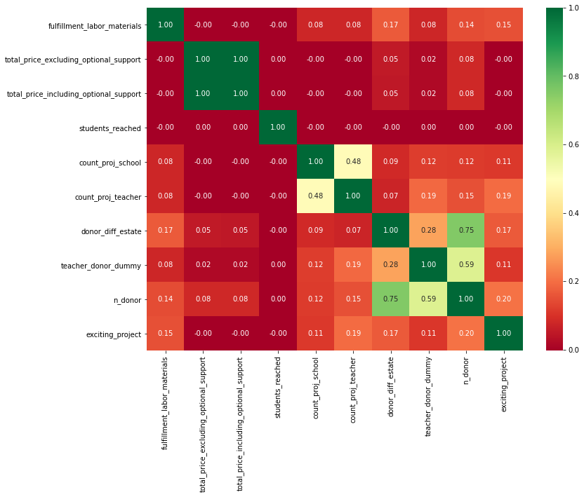
Exploratory Data Analysis- Projects
was created 2 new variables for the dataset related to donor:
S, n_donor (the number of donors per project
Donors_diff_state (the number of donors from different state of the project)
Count_project_teacher (number of exciting projects which the teacher has)
40 k
15 k
55 k
40 k
For the analysis the outliers were replaced for the median when the number was higher the 2 times the std + median.
15 k
15 k

Slide 12
KPIs Suggeted
Number of exciting projects/ total Number of projects.
Projects carried out by teachers with a successful track record.
School projects with a successful track record.
Number of donors per project, local and from another estate.
The length of the messages by project.
Number of messages by project.
Projects from schools from a high-income area.
Projects from schools in urban areas.
55 k
40 k
A dashboard with examples will be show
15 k

Slide 13
Further analysis
A logistic regression was performed to classify the projects with variables high correlated with the classifier, but the results were still inconclusive.
Try the model with different parameters or different models as random forest tree.
Classify schools and teachers with a cluster analys (K-means).
Use Natural Language Processing to identify trends in the comments from the donors.
55 k
40 k
15 k

